Slide 1
Fire Detection using CNN & mobile-net models.
Team members:
Roshini Joga (1602-19-737-035)
Jampelly Sai Rishitha(1602-19-737-036)
Internal Guide:
Mrs .S. Aruna

Slide 2
PROBLEM STATEMENT
We aim to develop a fire detection system to handle more complex fire accidents using Convolutional Neural Networks (CNN) through surveillance images.

Slide 3
ABSTRACT
The recent advances in embedded processing have enabled the vision based systems to detect fire during surveillance using convolutional neural networks (CNNs). In this research paper, we propose a cost-effective fire detection CNN architecture for surveillance videos. The model is inspired from GoogleNet architecture, considering its reasonable computational complexity and suitability for the intended problem compared to other computationally expensive networks such as AlexNet. To balance the efficiency and accuracy, the model is fine-tuned considering the nature of the target problem and fire data. Experimental results on benchmark fire datasets reveal the effectiveness of the proposed framework and validate its suitability for fire detection in CCTV surveillance systems compared to state of-the-art methods.

Slide 4
Literature survey
T. Çelik and H. Demirel, ‘‘Fire detection in video sequences using a generic color model,’’ Fire Safety J., vol. 44, no. 2, pp. 147–158, 2009.
In this paper, a rule-based generic color model for flame pixel classification is proposed. The proposed algorithm uses YCbCr color space to separate the luminance from the chrominance more effectively than color spaces such as RGB or rgb.

Slide 5
B.U. Töreyin, Y. Dedeoğlu, U. Güdükbay, and A. E. Çetin, ‘‘Computer vision based method for real-time fire and flame detection,’’ Pattern Recog- nit. Lett., vol. 27, pp. 49–58, Jan. 2006. ​
Automated fire detection is an active research topic in computer vision. In this paper, we propose and analyze a new method for identifying fire in videos. Computer vision-based fire detection algorithms are usually applied in closed-circuit television surveillance scenarios with controlled background.
P. Foggia, A. Saggese, and M. Vento, ‘‘Real-time fire detection for video- surveillance applications using a combination of experts based on color, shape, and motion,’’ IEEE Trans. Circuits Syst. Video Technol., vol. 25, no. 9, pp. 1545–1556, Sep. 2015.
In this paper, we propose a method that is able to detect fires by analyzing videos acquired by surveillance cameras. Two main novelties have been introduced. First, complementary information, based on color, shape variation, and motion analysis, is combined by a multiexpert system.

Slide 6
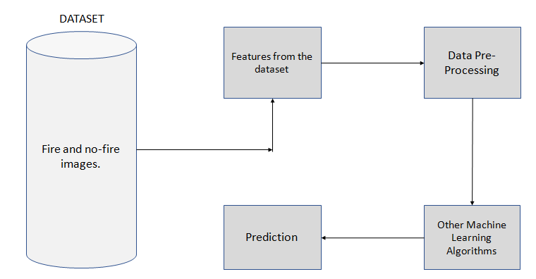
PROPOSED WORK.
We aim to examine this project with various other models and different challenging datasets.

Slide 7
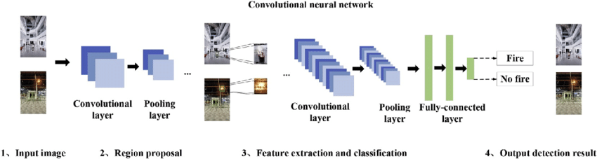
CNN ALGORITHM

Slide 8
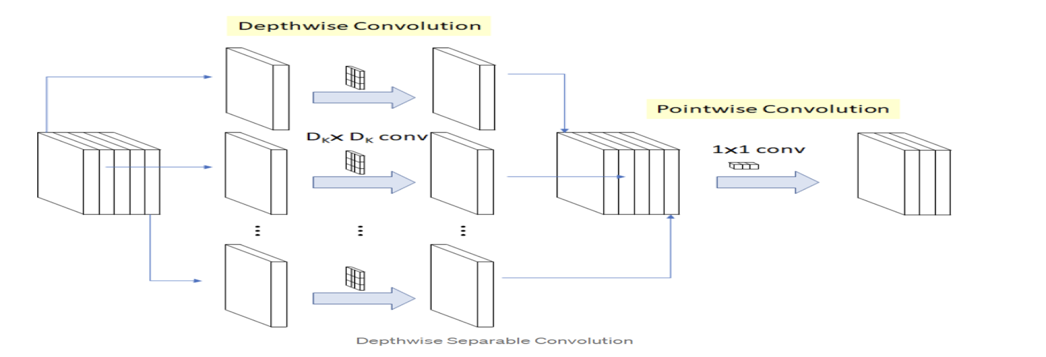
Mobilenet algorithm

Slide 9
RESOURCES IDENTIFIED
DATASET: Kaggle
https://www.kaggle.com/datasets/brsdincer/wildfire-detection-image-data
SOURCE CODE: Kaggle
https://www.kaggle.com/code/mayureshnm/forest-fire-detection-using-cnn

Slide 10
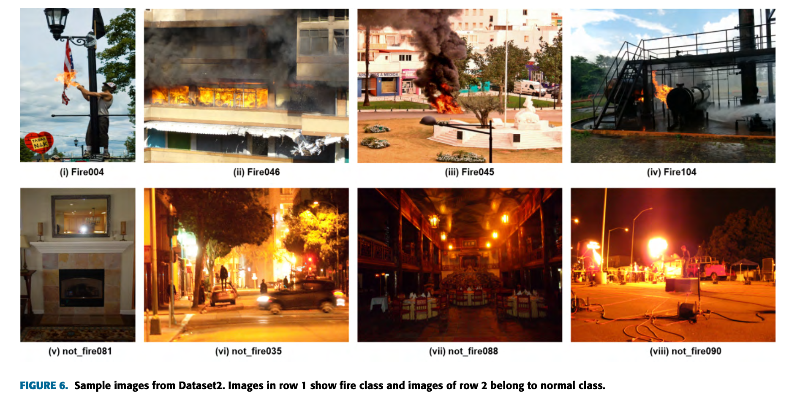

Slide 11
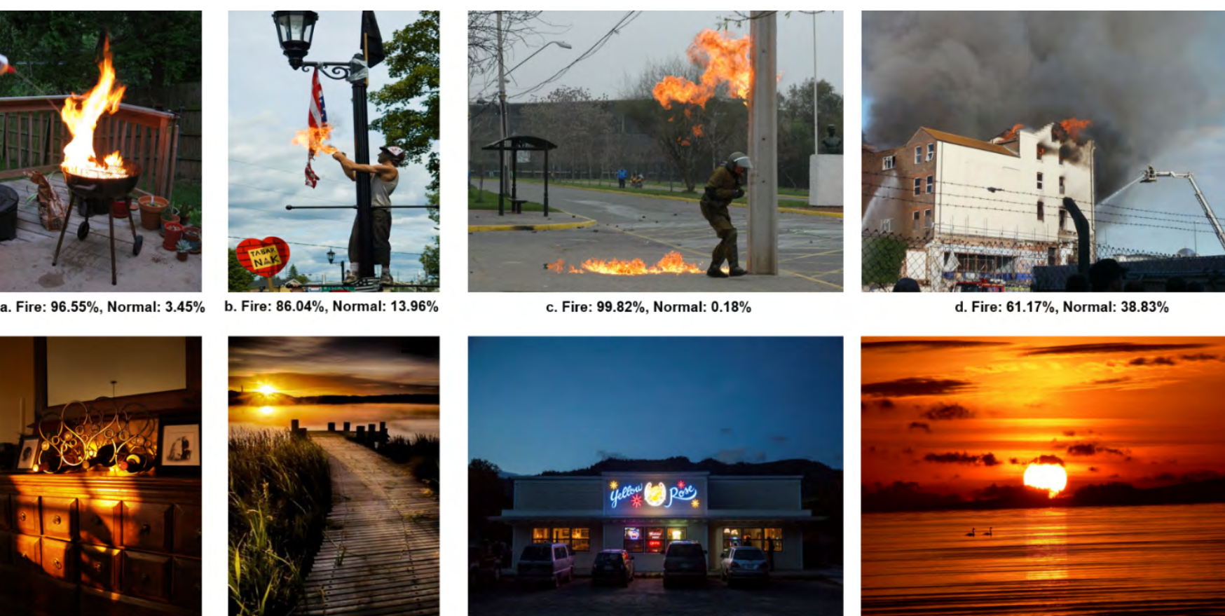

Slide 12
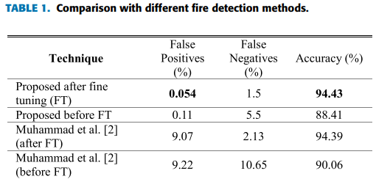
Results of the base paper
Courtesy: K. Muhammad et al.: CNNs Based Fire Detection in Surveillance Videos

Slide 13
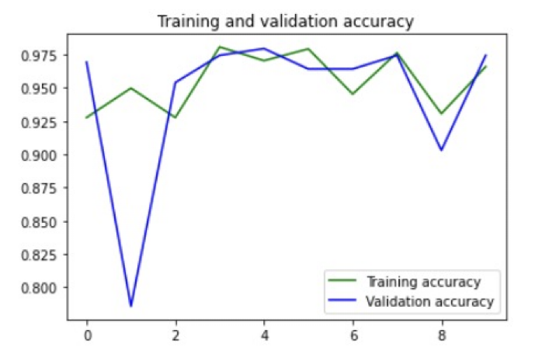
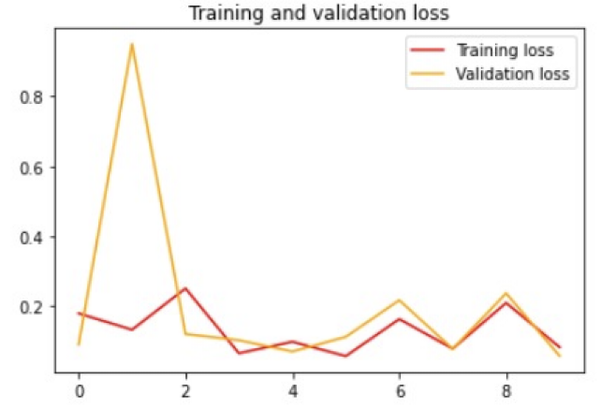
Results of mobilenet :

Slide 14
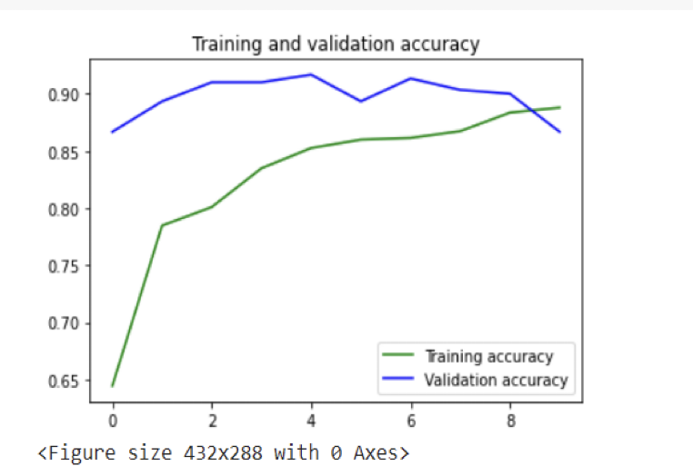
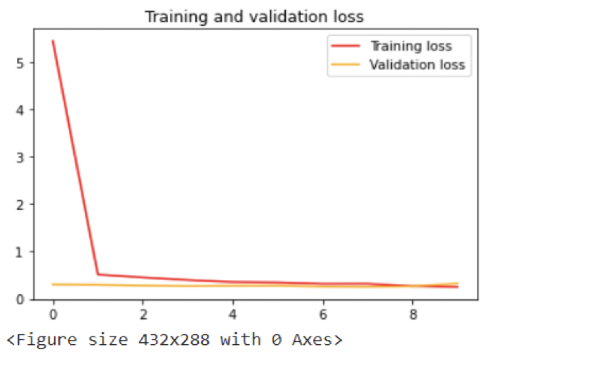
Results of cnn:

Slide 15
METRICS
Accuracy.
Precision.
Recall.
F-Measure.

Slide 16
Requirements
Hardware requirements: Computer with atleast 8 GB RAM i5 Processor
Software requirements:
Google collab
Technolgies:
Tensorflow
Matplotlib
Keras
Numpy

Slide 17
CONCLUSION & FUTURE SCOPE
Our application can be improved by utilizing a bigger dataset of fires at different stages and proportions to train the model.
With more significant GPU capability, we may deploy two deep learning models for characteristic examination, with their results feature vectors connected and categorized for improved robustness
Model can be embedded to a IoT device like Rasberry pi, Arduino to alert surroundings.

Slide 18
THANK YOU

